Slide 1
Benchmark Compression with Near-Sortedness
By -
Shivangi
Vani Singhal

Slide 2
Background

Slide 3

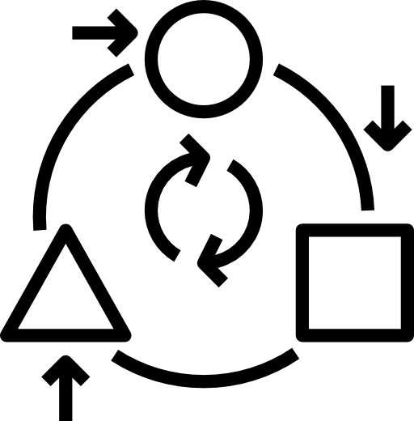
Why need data compression?
Large amount of data generated
Run out of resources soon

Slide 4



Motivation
Degree of Sortedness
Completely Sorted or Unsorted Data
Problem Statement
Explore the Performance

Slide 5
Workload

Slide 6


Different size of Workload
Different values of K-L (Varying Sortedness)

Slide 7





5 Compression Algorithms
Run Length Encoding
Delta Encoding
Snappy
LZ77
Huffman

Slide 8
Results

Slide 9
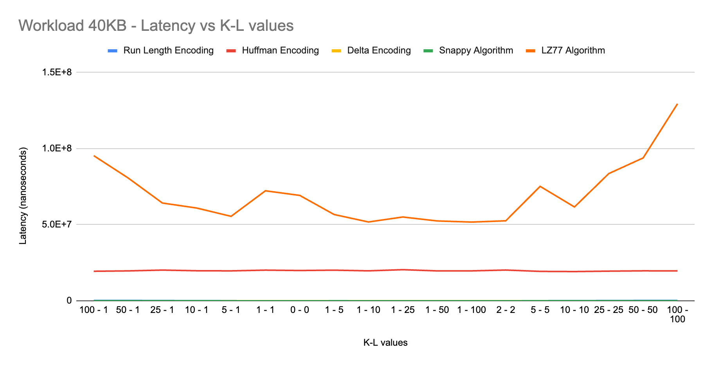
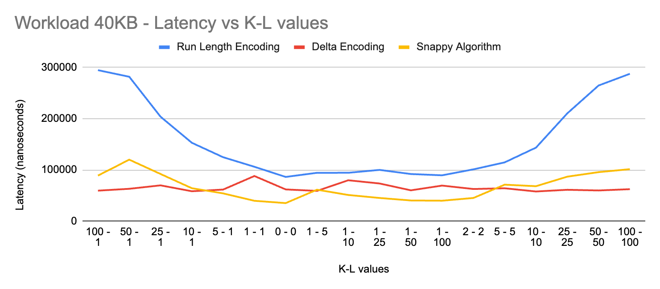
Workload 40KB

Slide 10
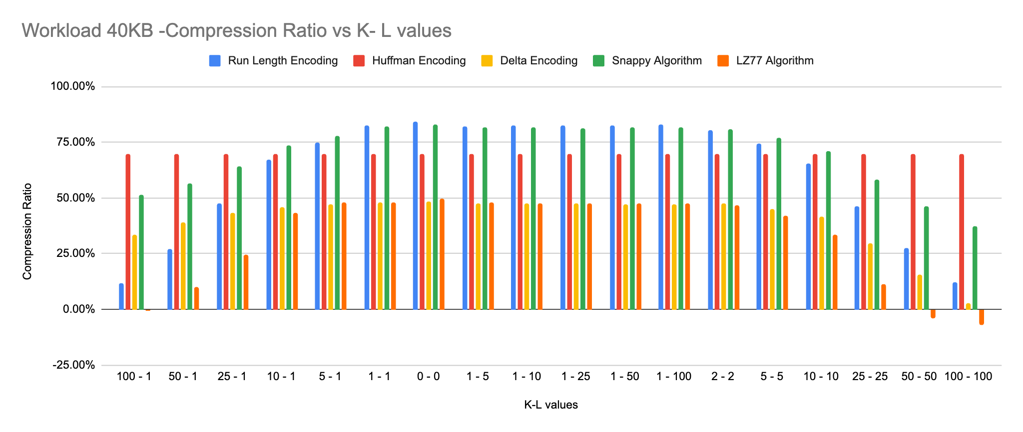

Slide 11
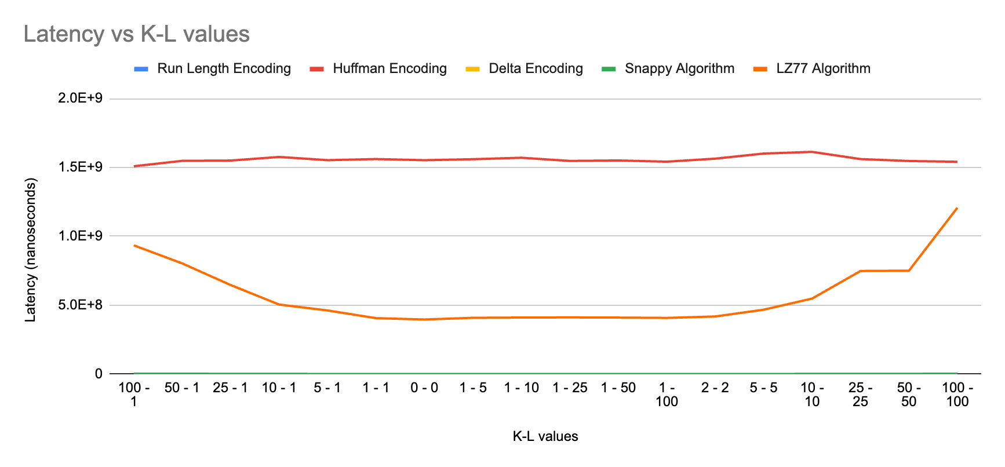
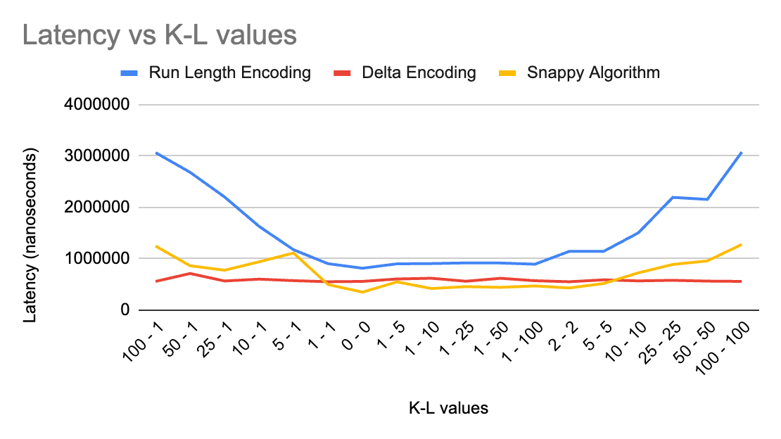
Workload 400KB

Slide 12
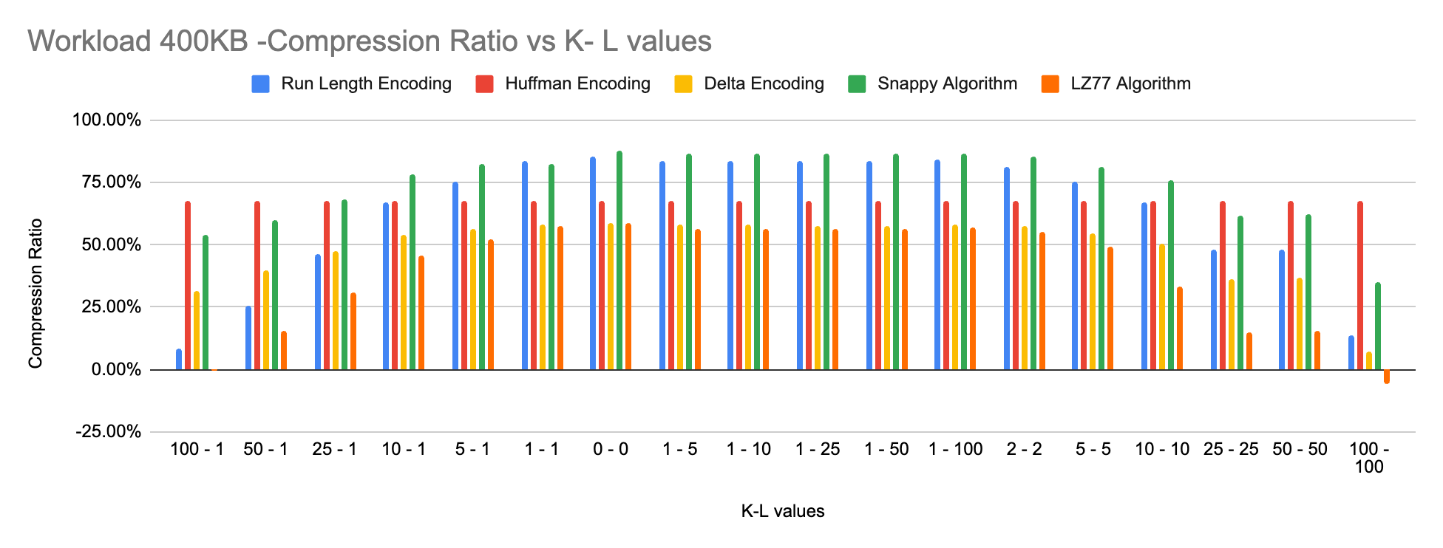

Slide 13
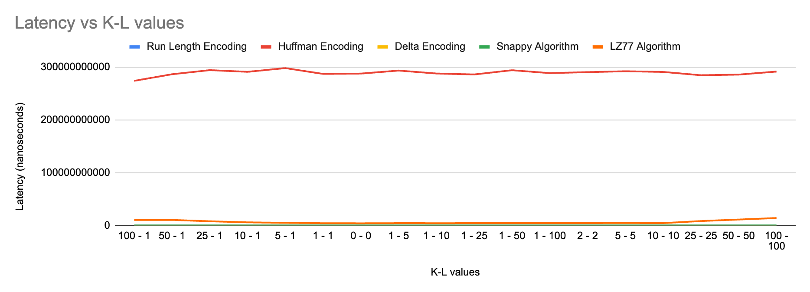
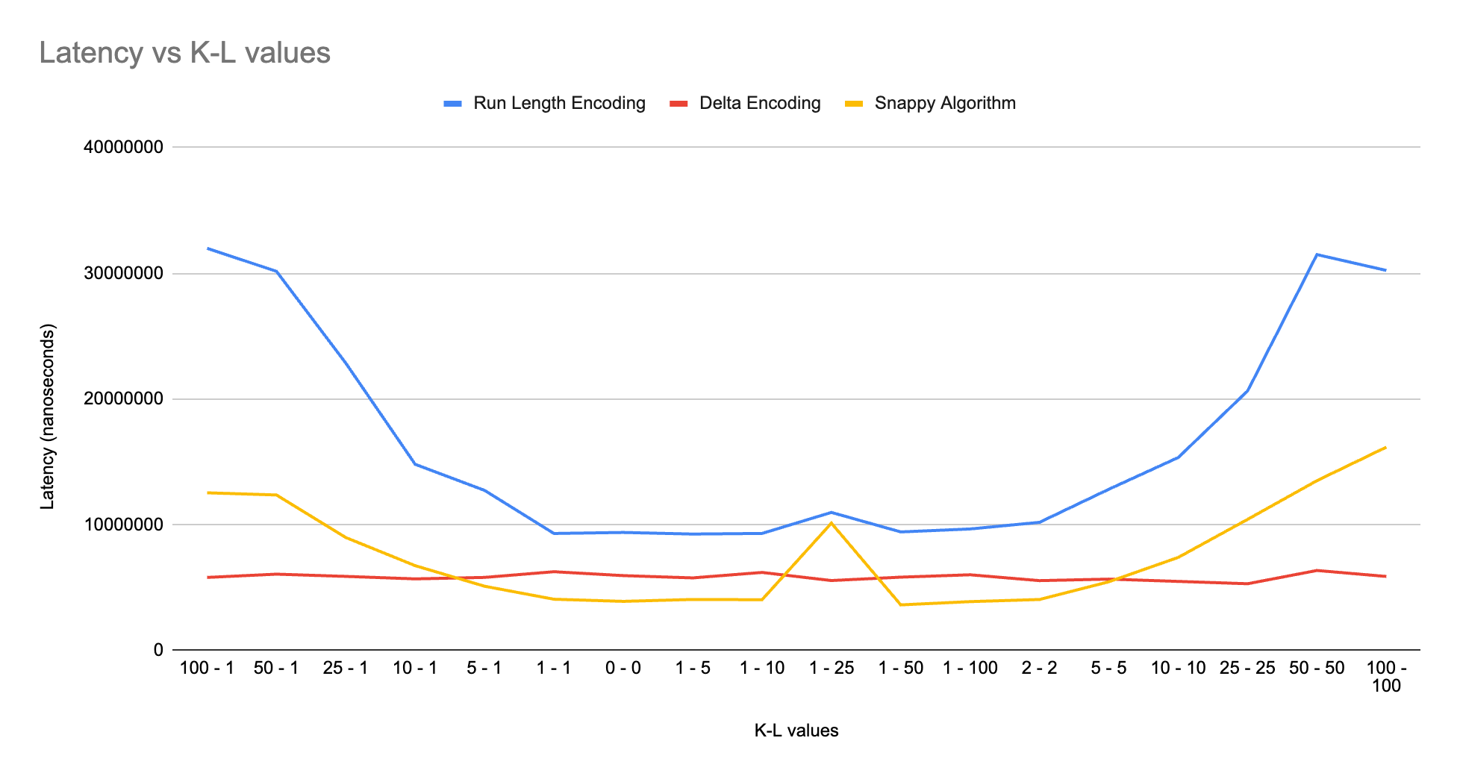
Workload 4MB

Slide 14
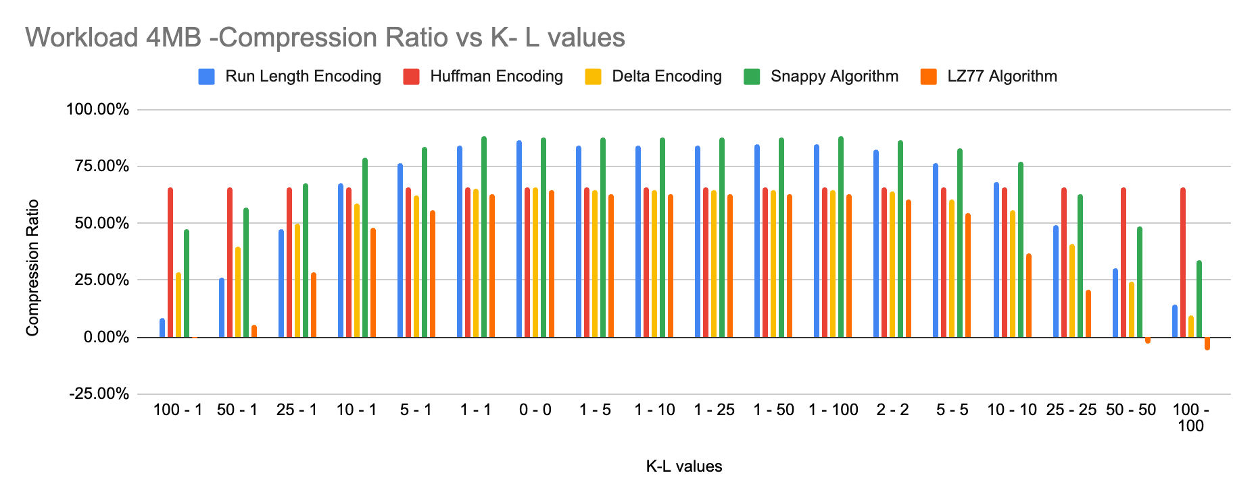

Slide 15
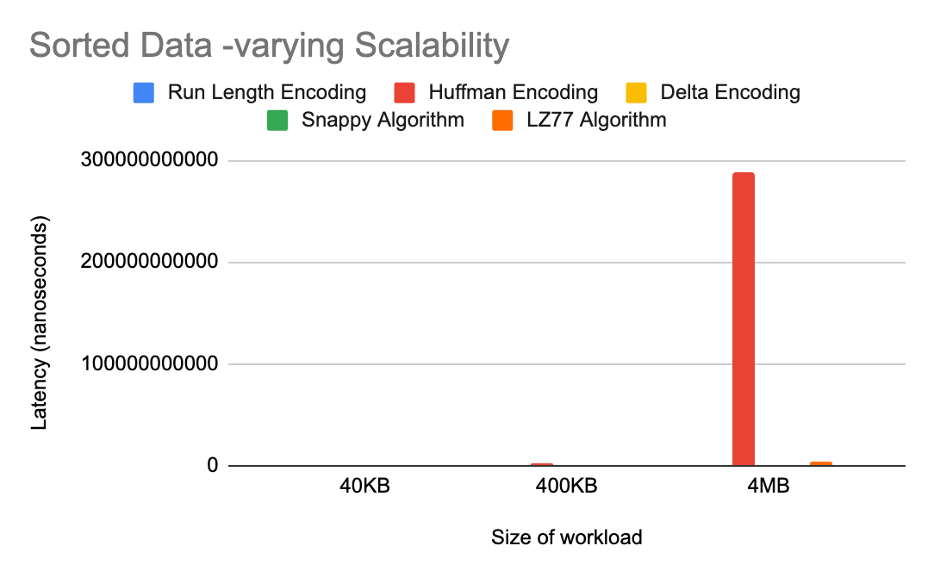
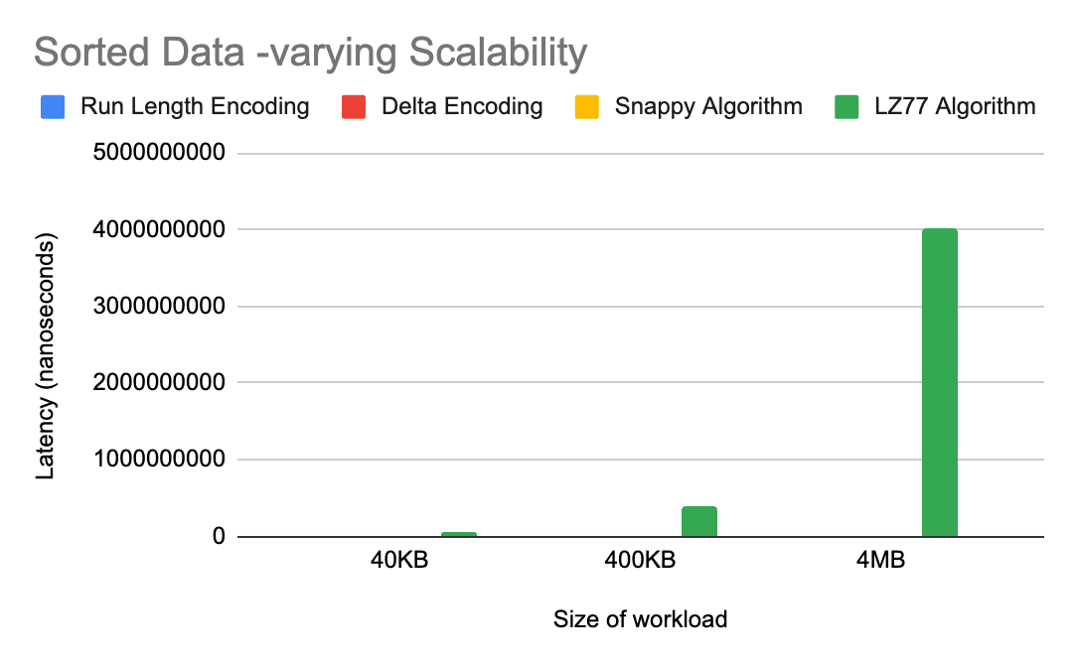
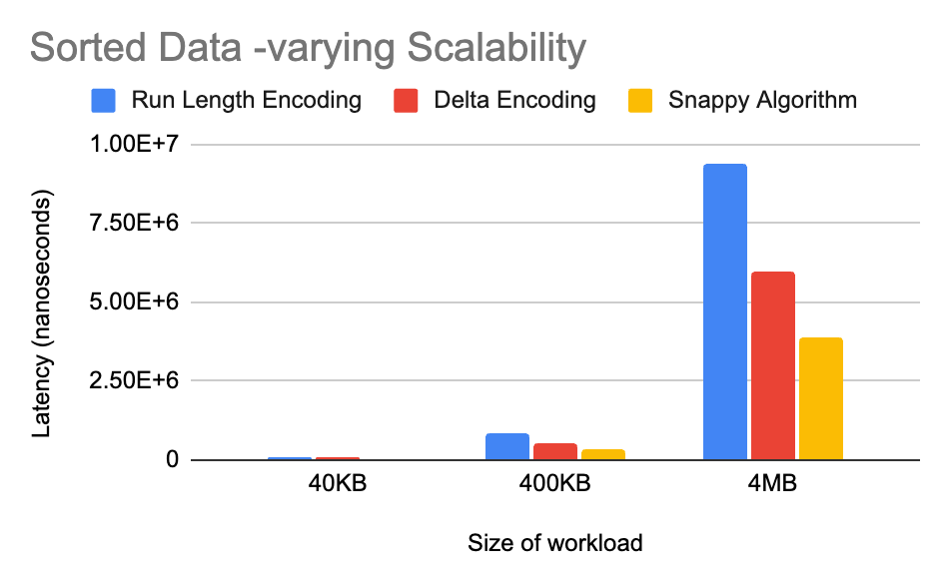
Scalability for Sorted Data

Slide 16
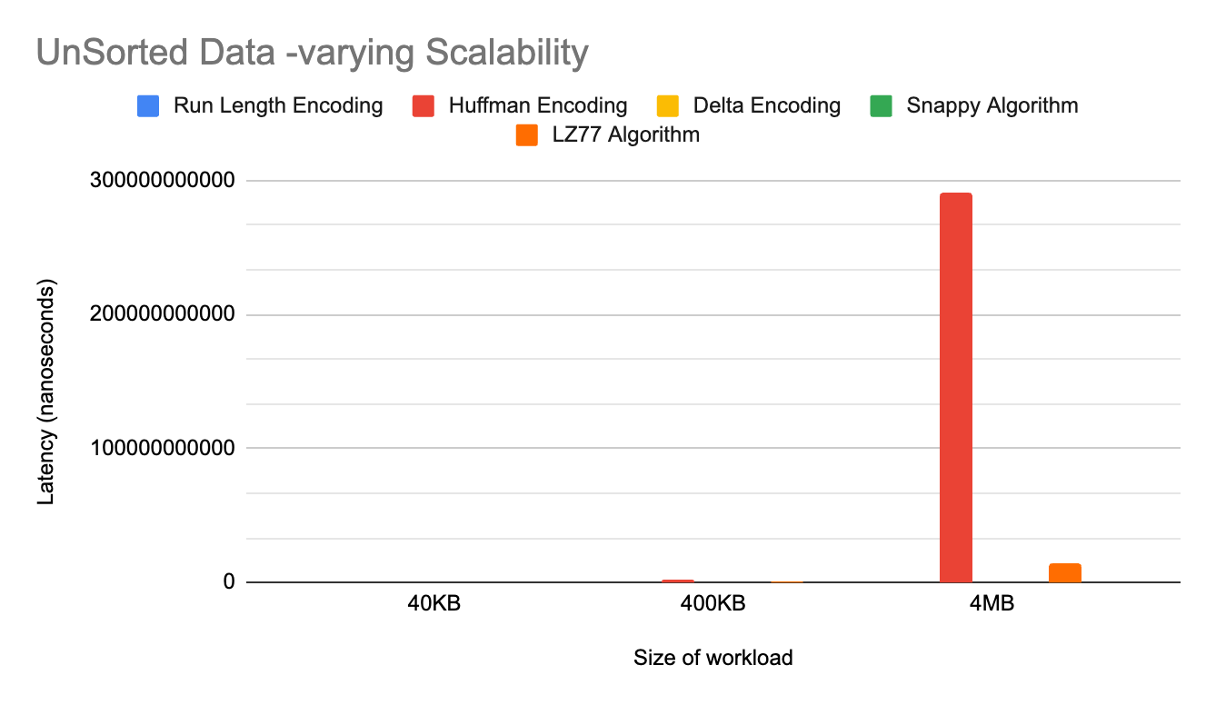
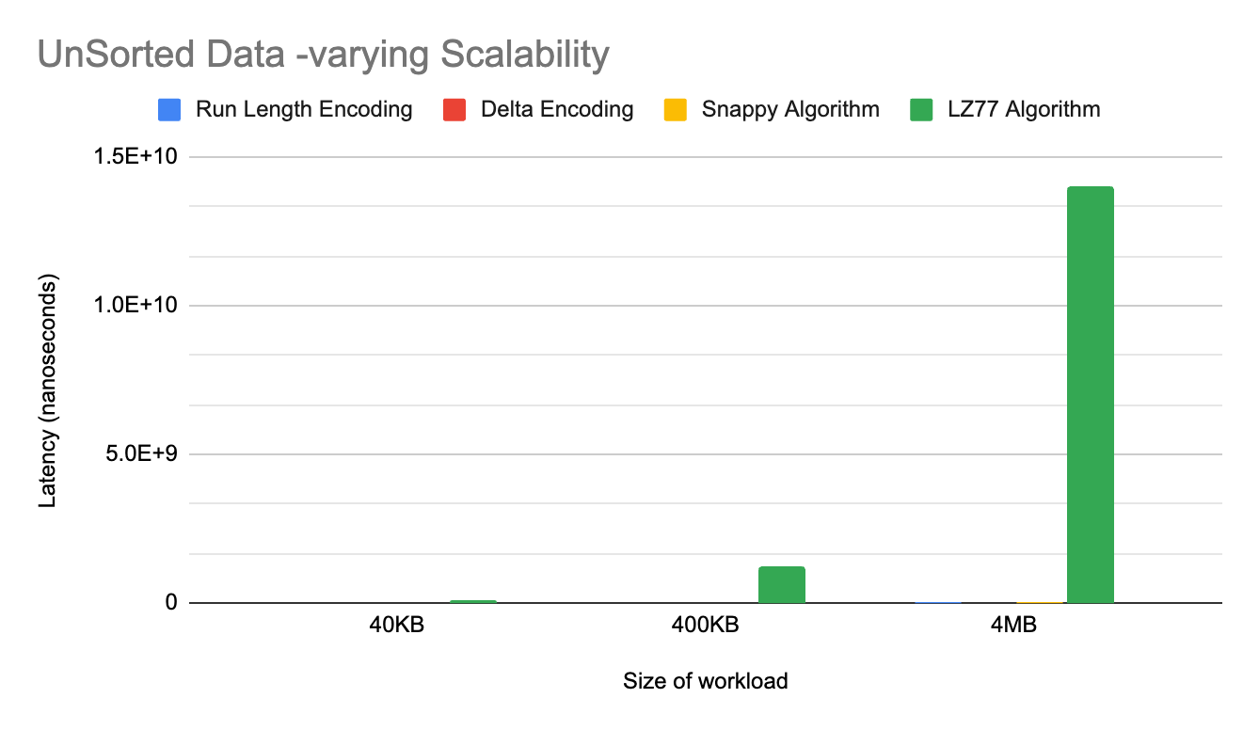
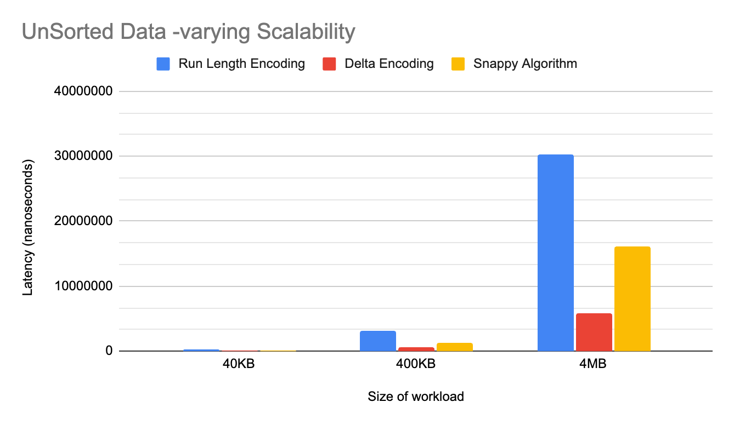
Scalability for Unsorted Data

Slide 17
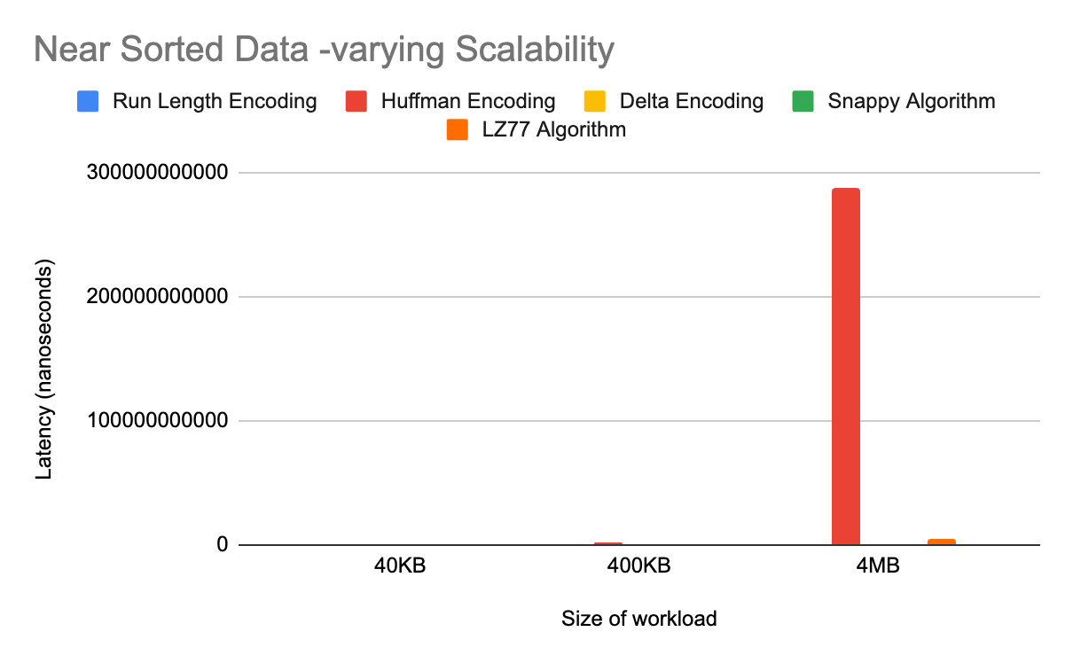
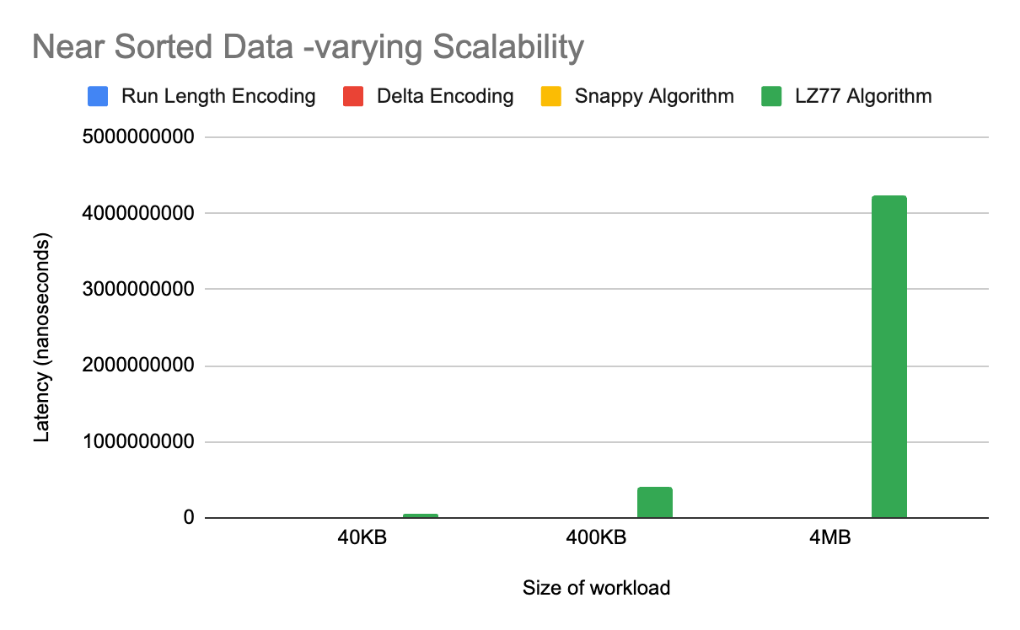
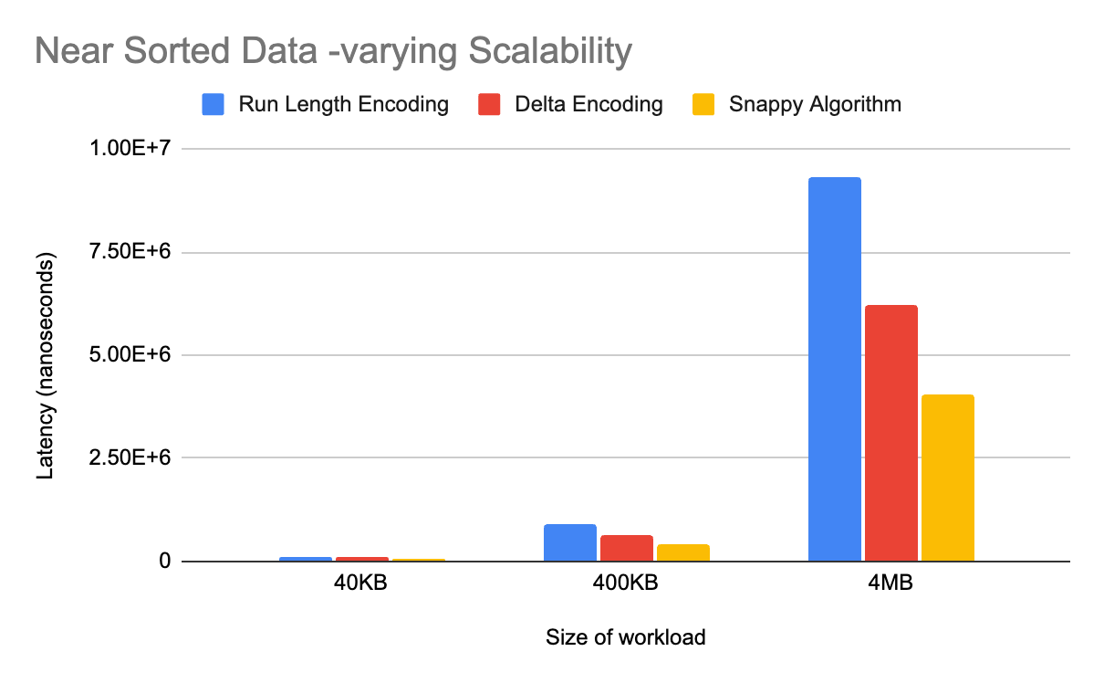
Scalability for Near Sorted Data

Slide 18


Next Steps
Unique Data
Larger Size of Workload - 40MB and 400MB

Slide 19
Questions ?

